Slide 1
When Milliseconds Matter: Evaluating the Vulnerability of High-Frequency Trading Models to Adversarial Manipulation
Karmabir Chakraborty
Thesis Defense (Spring, 2025)
Advisor: Dr. Hajime Shimao

Slide 2
Presentation Flow
Introduction
Problem Understanding
Research Questions and Framework
Methodology
Key Observations and Takeaway
Future Research Directions

Slide 3
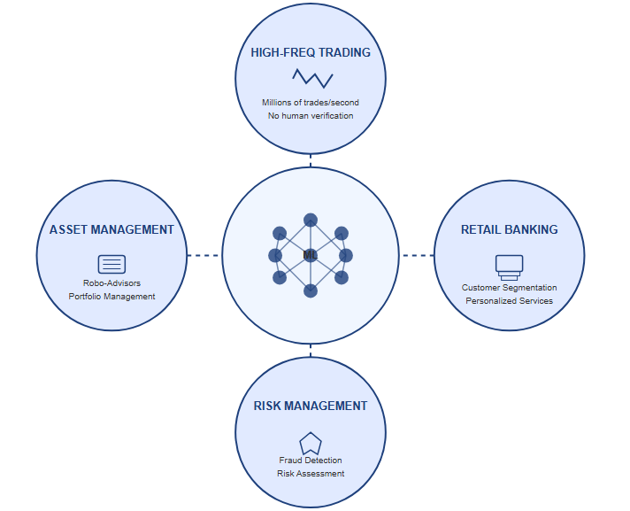
Introduction: The ML Revolution in Finance
Widespread ML adoption across financial sectors:
Robo-advisors managing portfolios
Fraud detection systems identifying illicit transactions
Automated risk assessment for lending decisions
High Frequency Trading (HFT) at the forefront:
Extremely fast execution (microsecond to millisecond timeframes)
High volume of trades (thousands to millions daily)
Fully automated decision-making
Notes:
Time Horizon
Traditional: Hours, days, weeks, or years between trades
HFT: Microseconds to milliseconds; holding periods often measured in seconds
Trading Volume
Traditional: Moderate number of trades (dozens to hundreds daily)
HFT: Massive volume (thousands to millions of trades per day)
Decision Making
Traditional: Often involves human judgment, fundamental analysis, technical indicators
HFT: Fully automated algorithms with no human intervention during trading

Slide 4
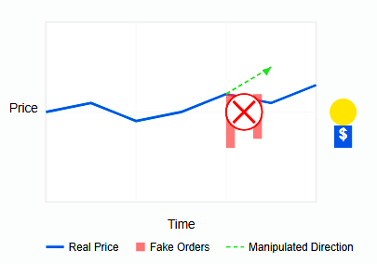
Introduction: Market Manipulation - A Long Standing Issue
Spoofing:
Practice of placing orders with no intention to execute
Designed to create false impressions of market activity and manipulate prices
Involves placing and quickly canceling large orders on one side of the market to artificially move prices, then profiting from positions on the opposite side
Market manipulation has existed for decades:
Existed since the beginnings of organized markets
Documented cases date back to the 1800s in commodity markets, where traders would coordinate to create artificial price movements in agricultural futures

Slide 5
Introduction: Notable Spoofing Cases
JP Morgan (2020):
Paid $920M settlement for eight years of manipulation
Traders placed thousands of fake orders across precious metals and Treasury markets
Largest spoofing settlement in financial history
Tower Research Capital (2019):
$67.4M settlement for spoofing in futures markets
Demonstrated how quantitative trading firms could leverage algorithms for market manipulation
Flash Crash (2010):
Market plunged ~1,000 points (9%) in minutes before recovering
Navinder Singh Sarao's spoofing activities contributed to market instability
Resulted in $40M in profits, eventual criminal charges

Slide 6
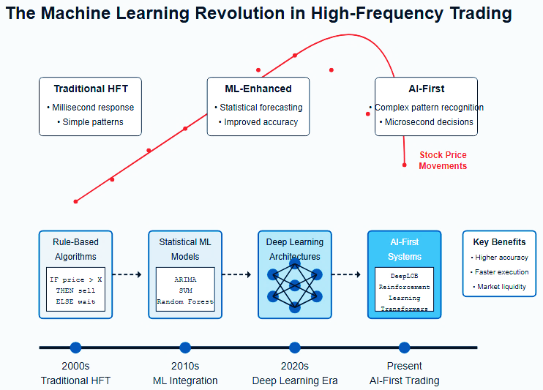
Introduction: From rigid rules to adaptive systems
Evolution of predictive models:
From statistical methods (VAR, ARIMA) to neural networks
Superior predictive accuracy on benchmark datasets
Key Advantage:
Automatic identification of complex patterns driving short-term price movements
Improved forecasting of mid-price movements at various time horizons

Slide 7
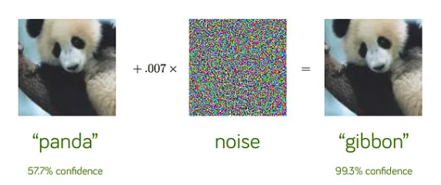
Introduction: Can machines be fooled?
ML models are not perfect—they can be fooled with tiny modifications
Adversarial Attacks:
Can exploit the gradient or decision boundaries of machine learning models
Target areas where the model has high confidence but low robustness
Require minimal changes to achieve maximum impact
Example:
Image Classification: Changing a few pixels can make a panda look like a gibbon
Autonomous Vehicles: Small stickers on road signs trick self-driving cars
Notes:
A computer can learn to tell the difference between a panda and a gibbon by studying lots of animal pictures.
Someone can trick the computer by adding tiny dots to a panda picture that humans can't notice.
These special dots make the computer think the panda is actually a gibbon, even though it still looks exactly like a panda to people.
It's like having a secret code that makes the computer see wrong things, similar to wearing camouflage to hide from someone.

Slide 8
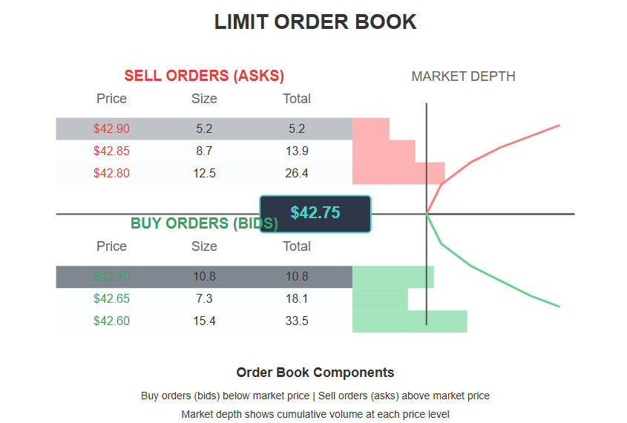
Introduction: Limit Order Books (LOB)
Primary information source for HFT Systems
Show real-time, detailed lists of all pending buy (bid) and sell (ask) orders for a specific security
Display the exact price and quantity of each order
Allow traders to see market depth (all pending orders at various price levels)
Provide a complete view of supply and demand at each price point
Used in more than half of today's electronic markets
Multi-dimensional structure organizing orders by price levels
Notes:
Matching conditions:
A trade executes when:
A buy order's maximum price meets or exceeds a sell order's minimum price
Both orders have available quantity to trade
Execution priority: When multiple orders could match, the system follows rules:
Price priority: Better-priced orders execute first (higher bids or lower asks)
Time priority: For orders at the same price, those placed earlier execute first (first-in-first-out)
Matching mechanisms:
Continuous matching: Trades execute immediately when matching conditions are met
Auction matching: Orders accumulate and execute at specific times (e.g., market open/close)

Slide 9
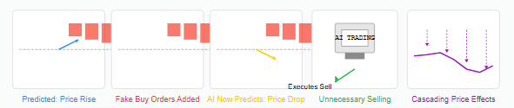
Introduction: How Adversarial Attack Can Manipulate a Trading Model
Spoofer places large buy orders at prices slightly below the current market
Other traders see this apparent support and become confident to buy
Once enough genuine buyers enter the market, the spoofer quickly cancels their buy orders and instead places large sell orders
This sudden reversal in apparent market sentiment can trigger a price drop
Notes:
A series of fake buy orders that repeatedly get canceled can create an impression of failed attempts to move the price higher
This perceived failure can discourage genuine buyers
When real buying interest diminishes, prices can fall naturally

Slide 10
Introduction: Regulation vs. Technology
Current Regulatory Landscape:
Traditional markets have anti-spoofing measures but focus on human-speed manipulation
Market manipulation prohibited under Dodd-Frank and EU's MAR
Technology-Regulation Gap:
Algorithmic and High-Frequency Trading evolve faster than regulatory frameworks
Sub-millisecond transactions exceed monitoring capabilities
Adversarial AI Blind Spot:
No specific regulations addressing ML-based vulnerabilities or adversarial attacks
HFT firms rely on proprietary solutions with no standardized defence framework
Regulators lack technical expertise for AI-specific manipulation assessment

Slide 11

Introduction: Why this Research Matters?
Growing threat in financial market:
Modern HFT systems leverage sophisticated machine learning models
While extensively documented in computer vision and NLP, the susceptibility of financial models to adversarial manipulation remains dangerously unexplored.
Even minor, strategically-crafted perturbations in order book data can trigger incorrect trading decisions with significant financial consequences
This study provides the first comprehensive analysis of how adversarial vulnerabilities in HFT models could threaten individual traders and broader market stability

Slide 12
Problem understanding – Deep Learning Models on LOB Dataset
Research Domain | Key Highlights and Takeaways | References
Deep Learning Models on LOB Dataset | Created a hybrid neural network model consisting of CNN and LSTM Evaluated against the FI-2010 and LSE dataset which were z-score normalized | [1]
Overview and Challenges to WQIs | Created a model only consisting of a fully connected convolutional network Input data consisted of 10 days for 5 different companies worth of data | [2]
Overview and Challenges to WQIs | The question this study wanted to answer is whether the Transformer-based model can be applied in financial time series prediction and beat LSTM. Models were evaluated on three prediction tasks on LOB data which are mid-price prediction, mid-price difference prediction, and mid-price movement prediction. For mid-price movement prediction, a new LSTM model called DLSTM is proposed which incorporates time series decomposition. | [3]
 | Hybrid CNN-LSTM Model for Trend Analysis in High-Frequency Trading: The study combines CNN (to extract spatial features from Limit Order Books) and LSTM (to capture temporal dependencies) for predicting market trends in high-frequency trading (HFT). Improved Accuracy Using FI-2010 Dataset: The model is tested on the FI-2010 LOB dataset, demonstrating superior performance over traditional machine learning methods like SVMs and standalone deep learning models, making it highly effective for real-time trade decision-making. | [4]
Notes:
Time Series Decomposition is a statistical technique used to break down a time series into its fundamental components to better understand and analyze its behavior. The main goal is to separate different patterns in the data, making it easier for machine learning models to capture trends, seasonality, and noise.
Components of Time Series Decomposition:Trend, .Seasonality, Residual/Noise (R), Cyclic Component (C)

Slide 13
Problem understanding – Adversarial Attacks
Research Domain | Key Highlights and Takeaways | References
Adversarial Attacks | Problem addressed: Vulnerability of deep learning regression models for multivariate time series forecasting to adversarial attack Applied FGSM and BIM | [5]
Overview and Challenges to WQIs | Provides a comprehensive review of adversarial examples in deep learning The authors propose a taxonomy to categorize adversarial attacks along three dimensions: threat model, perturbation, and benchmark Applied FGSM, PGD, BIM, DeepFool, and others. | [6]
Overview and Challenges to WQIs | The paper evaluates attacks and defenses primarily on MNIST and CIFAR10 image classification datasets. Experiments compare different attacks on MNIST and CIFAR10, showing gradient-based attacks like PGD are most effective but score-based and decision-based attacks can also fool classifiers in a black-box setting | [7]
 | Introduces the threat of black-box adversarial attacks on deep neural networks based on time series classification Introduces a new method of black box attack called BlackTreeS Compares attacks such as FGSM, PGD, Substitute, NES, SPSA, AutoZOOM, and BlackTreeS on various models such as BiRNN, LSTM, CNN, TCN, and DynamicConv. The results showed that not only did BlackTreeS reduce most accuracy but also was stealthy than the rest of the models. | [8]
Notes:
PGD typically starts with random initialization within the permitted perturbation space BIM usually starts from the original input without randomization
Computational efficiency
Well-established theoretical foundations
Scalability to high-dimensional data
Simplicity in implementation

Slide 14
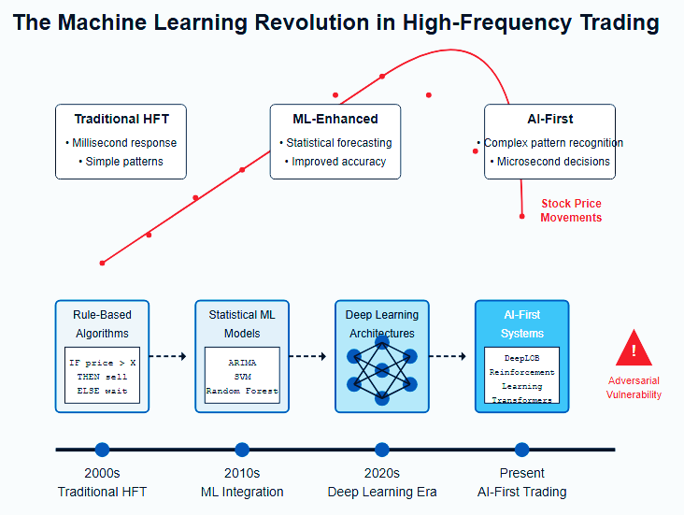
Research Questions and Framework
Key research questions:
How vulnerable are state-of-the-art HFT models to adversarial attacks?
What is the real-world financial impact of these vulnerabilities?
Which model architectures demonstrate greater resilience?
Comprehensive evaluation framework:
Baseline performance measurement
Adversarial attack implementation
Quantification of financial impact
Robustness of ML algorithms remains largely unexplored in financial contexts

Slide 15
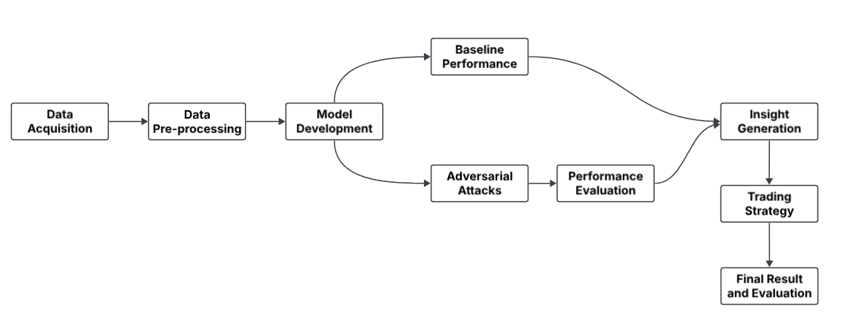
Methodology – Overview

Slide 16
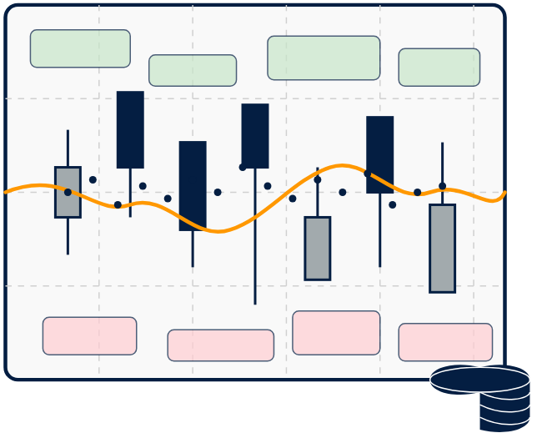
Data Acquisition
The dataset chosen for implementing models is the FI-2010 dataset [9] introduced in 2017
Dataset Overview:
Covers 5 liquid stocks traded on NASDAQ
Covers ten consecutive trading days (June 1-14, 2010)
Data Content:
Contains over 4 million events (order submissions, cancellations, modifications, and trade execution)
Records order book state changes at millisecond precision
Consists 10 levels of depth for bid and ask sides
Modelling Challenges:
High-dimensional data
Non-stationary
Complex microstructure dynamics

Slide 17

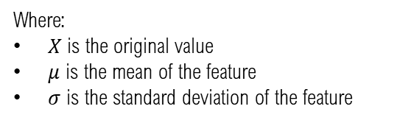
Data Preprocessing
Extraction and Structuring
Maintained the top 10 levels of bid and ask orders with associated volumes
Eliminated duplicate timestamp entries, and preserved on the first occurrence
Normalization
Used z-score normalization to preserve outliers proportionally and handles non-stationarity better
Processed price and volume features separately as distinct feature group maintaining the relative importance
Standardized each feature to have zero mean and unit variance to preserve relative relationships
Formula for z-score normalization
$$X_{normalized }= \frac{X − μ}{σ}$$
Where:
$X$ is the original value
$μ$ is the mean of the feature
$σ$ is the standard deviation of the feature
Notes:
Z-Score Normalization: EXCELLENT for preserving relative importance of price jumps in LOB data
Min-Max Normalization: Scales features to [0,1] range - Beneficial when bounded outputs are required
Decimal Scaling: Divides by powers of 10 - Simple but less effective for handling LOB volume variations

Slide 18

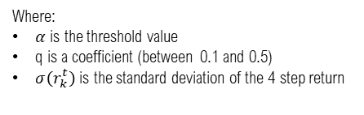


Data Preprocessing
Data Windowing
Created fixed-size input sequences using a sliding window approach
Set maximum records of history at 100 timestamps to capture sufficient temporal dynamics while maintaining computational efficiency
Labelling for Classification
Calculated volume-weighted mid-price using price and volume data
Computed forward returns over 4 steps ahead(prediction horizon)
Transformed continuous returns into a three-class classification problem using threshold α (0.002):
Upward movements (class 2): when returns exceed α
Downward movements (class 0): when returns fall below – α
Stationary periods (class 1): when returns remain within ± α
Formula to calculate volume-weighted mid-price(VWMP)
$VWMP$ = $\frac{WBP+WAP}{2}$
Where WBP and WAP are the weighted bid and ask prices, respectively:
$$WBP= \frac{\sum_{i=1}^{10}{{bp}_{i} ×{bv}_{i}}}{\sum_{i=1}^{10}{{bv}_{i}}}$$
$$WAP= \frac{\sum_{i=1}^{10}{{ap}_{i} ×{av}_{i}}}{\sum_{i=1}^{10}{{av}_{i}}}$$
Where
${bp}_{i}$ is the bid price at level i
${bv}_{i}$ is the bid volume at level i
${ap}_{i}$ is the ask price at level i
${av}_{i}$ is the ask volume at level i
Formula to calculate $α$ value
$$α=q × σ(r_{k}^{t})$$
Where:
$α$ is the threshold value
q is a coefficient (between 0.1 and 0.5)
$σ\left(r_{k}^{t}\right)$ is the standard deviation of the 4 step return
Notes:
The Volume Weighted Mid Price (VWMP) is calculated to provide a more accurate market price representation by accounting for trading volume at each price level, giving a more realistic view of where significant trading activity is actually occurring.
Unlike basic mid prices, VWMP reduces the impact of outlier orders and better reflects the price at which substantial positions could actually be traded.

Slide 19
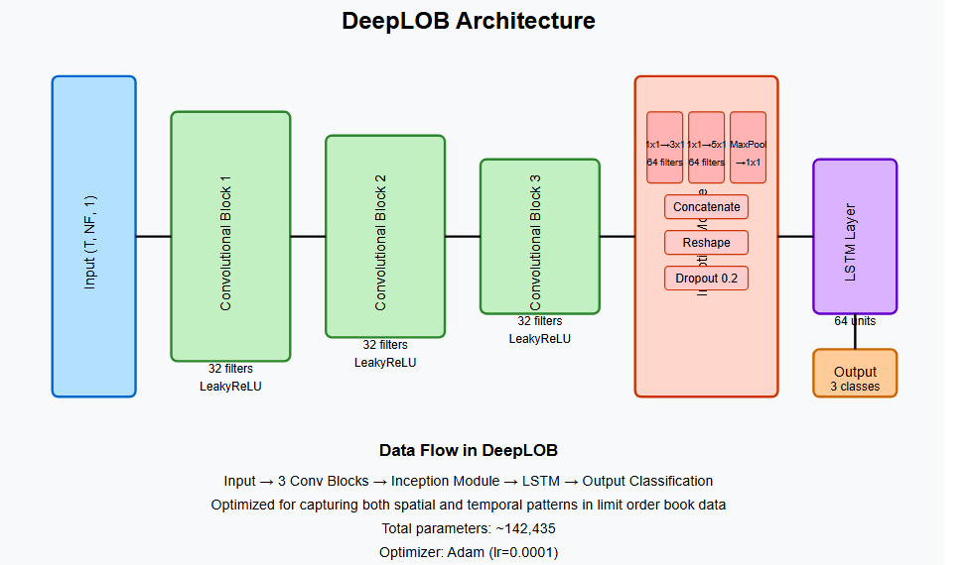
Model Development: DeepL0B
Purpose:
State-of-the-art architecture designed specifically for limit order book prediction
Key Components:
Convolutional block: Extracts spatial features from LOB data
Inception module: Multi-scale feature extraction
LSTM layer: Captures temporal dependencies
Notes:
DeepLOB uses deep CNN layers to extract spatial features from the Limit Order Book (LOB).
As CNNs get deeper, they suffer from vanishing gradients, meaning the earlier layers receive weak updates during backpropagation.
This slows down learning and can degrade accuracy.
Solution: Residual Connections (ResNet)
ResNet introduces skip connections (shortcuts) where the input of an earlier layer is added directly to the output of a deeper layer.

Slide 20

Model Development: CNN-1
Purpose:
Simple image-based feature extraction
Key Components:
Convolutional Blocks: Extract hierarchical features
Max Pooling: Reduces dimensionality, captures most important features
Dense layers: Final classification with softmax for 3-class output
Notes:
Takes in sequences of data with 40 features across 100 time steps
Uses filters to scan for patterns both across all features and over time
Gradually extracts more complex patterns through multiple layers
Compresses these patterns into a compact representation
Classifies each input sequence into one of three possible categories

Slide 21
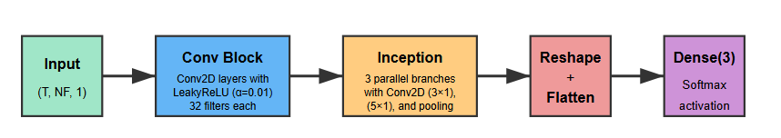
Model Development: CNN-2
Purpose:
More sophisticated feature extraction with inception-inspired design
Key Components:
Convolutional block: Prevents dying neurons
Strided convolutions: Efficient dimensionality reduction
Inception module: Parallel convolutions with different filter sizes
Concatenation: Combines multi-scale features for richer representation
Notes:
Takes time-series data and processes it through multiple convolutional layers
Applies a specialized "inception module" that looks at patterns of differrent sizes simultaneously
Combines these multi-scale patterns by concatenating them together
Reshapes and flattens the extracted features into a single vector
Classifies the input into one of three categories using softmax activation

Slide 22
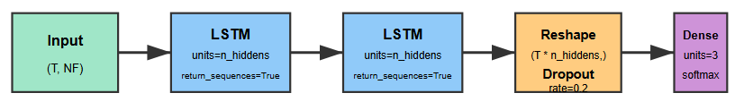
Model Development: LSTM-1
Purpose:
Captures temporal dependencies in sequential data
Key Components:
Stacked LSTM layers: Processes time-dependent patterns
Return_sequences=True: Preserves temporal information
Reshape + Dropout: Prevents overfitting
3-class softmax output: For directional prediction
Notes:
Takes time-series data as input with dimensions of time steps (T) and features (NF)
Processes the data through two stacked LSTM layers that maintain the time sequence
Reshapes the output to flatten the time dimension while preserving all features
Applies dropout (20%) to prevent overfitting
Classifies each sequence into one of three categories using a softmax layer

Slide 23
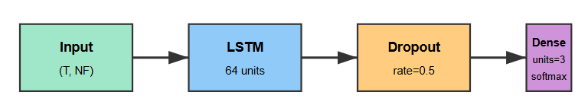
Model Development: LSTM-2
Purpose:
Simpler temporal modeling with regularization
Key Components:
Single LSTM layer: Extracts temporal features
Higher dropout: Stronger regularization
Lower learning rate: Finer optimization steps
3-class softmax: For directional prediction
Notes:
Takes sequential data with multiple features as input
Processes the entire sequence through a single LSTM layer with 64 units
Applies heavy dropout (50%) to prevent overfitting
Feeds the compressed representation into a final classification layer
Outputs probabilities for three possible categories using softmax activation

Slide 24
Baseline Performance
Accuracy
AUC

Slide 25
Baseline Performance
Precision
Recall

Slide 26
Baseline Performance - Observations
Performance Hierarchy:
DeepLOB and CNN-2 significantly outperform other models while LSTM models struggle with substantial train-test gaps suggesting poor generalization.
Class Imbalance Handling:
CNN-2 and DeepLOB maintain balanced performance across all classes while LSTM models show dramatic imbalance, particularly for class 1

Slide 27
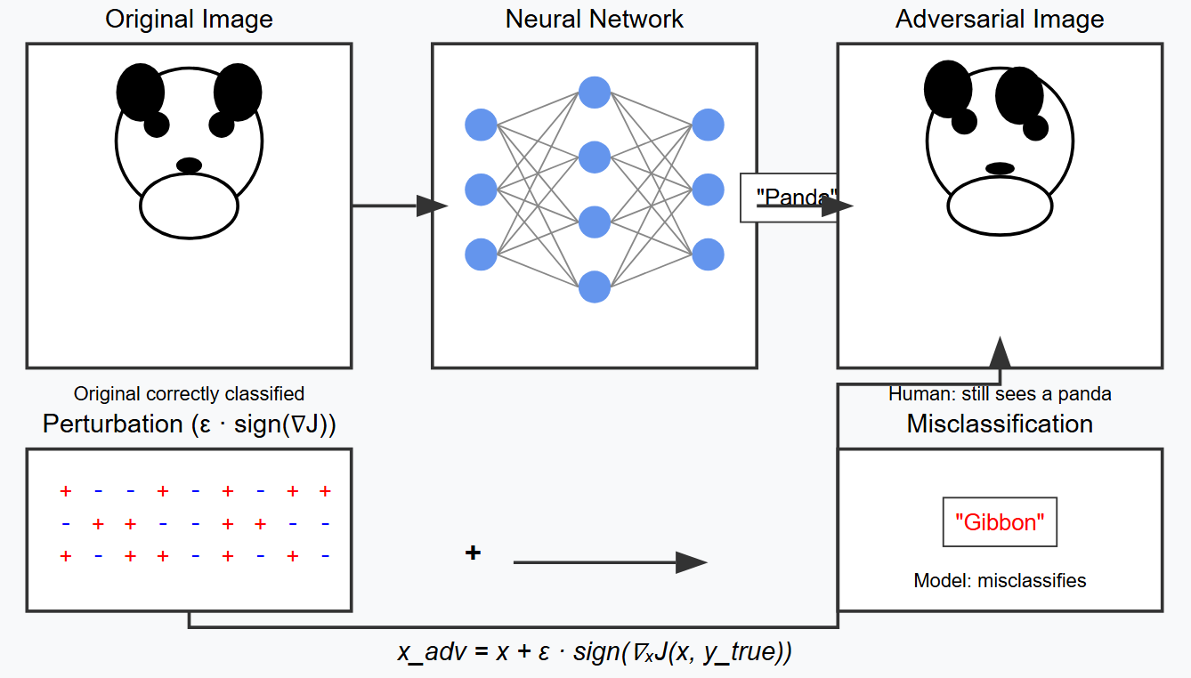

Adversarial Attacks: FGSM
Key Characteristics
Generates adversarial examples by adding a small perturbation in the opposite direction of the gradient(partial derivatives of the loss function with respect to each input pixel or feature).
Fast and computationally efficient
Single step attack
Formula:
$$x^{′}=x + ∈ ∙sign(∇_{x}J(θ, x,y))$$
Where:
$x^{′}$: Adversarial example (perturbed input)
𝑥: Original input
$∈$: Epsilon Value
$∇_{x}J\left(θ, x,y\right)$: Gradient of the loss function $J$ with respect to $x$
$θ$: Model Parameters
$y$: True label of the input 𝑥
$sign$($∙$): Takes the sign of the gradient (direction of maximum loss increase)
Notes:
Gradient Calculation: FGSM first calculates the gradient of the loss function with respect to the input.
This gradient essentially points in the direction that would make the model more confident in the correct classification.
Sign Operation: Instead of using the raw gradient values (which vary in magnitude), FGSM takes just the sign (positive or negative) of each element in the gradient matrix.
FGSM then adds a small perturbation in the opposite direction of this sign gradient, scaled by a small epsilon value:

Slide 28
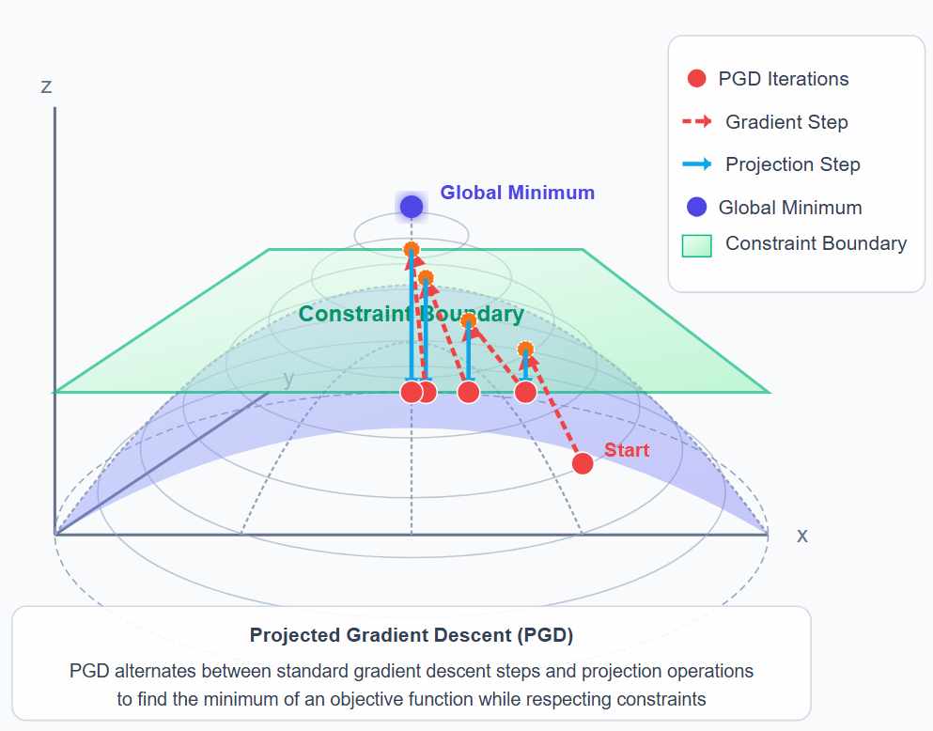

Adversarial Attacks: PGD
Key Characteristics
A multi-step iterative variant of FGSM
Iterative refinement within an 𝜖-ball around 𝑥, a bounded region around an input data point where small perturbations are allowed
Formula:
$$x_{t+1}= π_{β\left(x,ε\right)}(x_{t}+ α ∙sign(∇_{x}J\left(θ,x,y\right))$$
Where:
$x_{t}$: Adversarial example at iteration t
$x_{t+1}$: Updated adversarial example at iteration t + 1
$α$: Step size (how much we move in each iteration)
$π_{β\left(x,ε\right)}(∙)$: Projection operator that ensures $x_{t+1}$ stays within an 𝜖-ball around 𝑥
$β\left(x,ε\right)$: ϵ-ball (set of points within 𝜖-distance from 𝑥x)
Notes:
It finds a more optimal adversarial example by exploring the loss landscape thoroughly
It can escape local maxima that FGSM might get stuck in

Slide 29
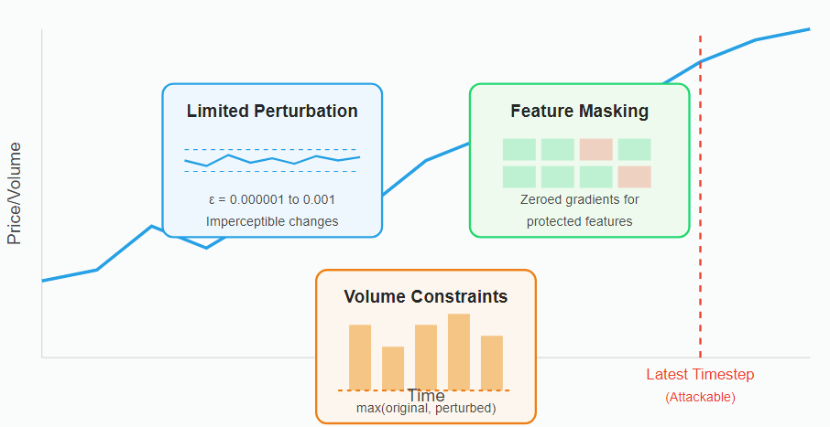
Adversarial Attacks: Constraints for HFT
Limited perturbation:
Purpose: Restricts attack magnitude to remain imperceptible
Implementation: Used small epsilon values
Effect: Ensures perturbations stay within bounded region around original data
Feature Masking:
Purpose: Targets only specific features to maintain realism
Implementation: Zeroed out gradients for protected features
Effect: Allows attacks only on the latest timestep since attackers can only manipulate current data and not historical records
Volume Constraints:
Purpose: Ensures perturbed values don't decrease below original values
Implementation: Took maximum between original and perturbed values
Effect: Prevents unrealistic volume reductions in financial data since volume decreases require cancelling actual orders already in the market, which an attacker typically cannot control

Slide 30
FGSM – Performance Evaluation

Slide 31
PGD - Performance Evaluation

Slide 32
Adversarial Attacks - Key Observations
Perturbation effectiveness in FGSM follows a three-phase pattern:
Initial high-volume but ineffective perturbations, followed by precise low-volume attacks that find the model's vulnerabilities, concluding with larger perturbations that overwhelm the model while expanding the attack space
Architectural Robustness Trade-off:
CNN-1's simpler architecture creates "incidental robustness" against adversarial attacks while complex models like CNN-2 and DeepLOB suffer dramatic performance drops demonstrating the fundamental accuracy-robustness trade-off
Attack Method Differences:
FGSM attacks cause catastrophic failure in LSTMs but maintain higher accuracy levels in CNN-2 and DeepLOB as compared to PGD attacks
PGD Vs FGSM Perturbation Volume:
PGD volume remains constant (~2.26) across all epsilon values due to iterative projection to constraint boundaries while FGSM volume varies directly with epsilon value, ranging from ~0.0004 (small epsilon) to ~4.5 (large epsilon)

Slide 33
Base Vs Attacked – Insights

Slide 34
Base Vs Attack –Observations
Performance Preservation Hierarchy:
CNN-2 maintains the highest absolute accuracy when attacked despite larger relative drops, suggesting more complex architectures may retain more functional capability even after significant degradation.
Precision-Recall Dynamics Under Attack:
Attacks generally impact precision more severely than recall across models indicating attacks primarily generate false positives rather than false negatives.
Notes:
Precision = TP/(TP+FP)
Recall = TP/(TP+FN)
If attacks primarily generate false positives (FP), then the denominator of precision increases significantly, causing precision to drop. Meanwhile, recall's denominator (TP+FN) remains relatively unchanged since FN isn't increasing as much

Slide 35
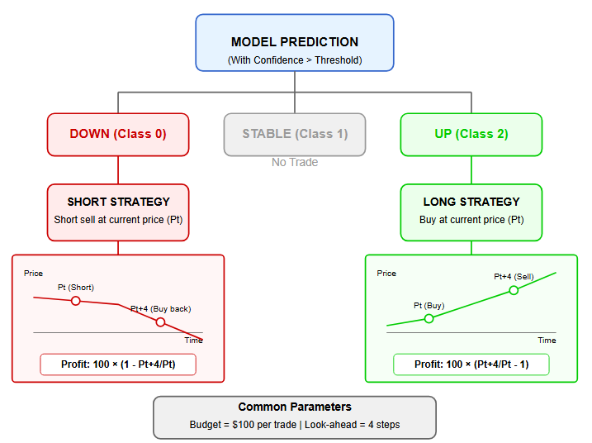
Trading Strategy
Prediction Strategy
Only trade when prediction confidence exceeds probability threshold
Ignore "stable" predictions and only act on directional predictions
Fixed budget of $100 per trade
"UP" Prediction Strategy
When model predicts UP with high confidence:
Buy shares at current mid-price (Pt)
Purchase 100/Pt shares
Sell all shares after 4 timesteps at future price
Profit formula: 100 × [Pt+4/Pt - 1]
"DOWN" Prediction Strategy
When model predicts DOWN with high confidence:
Short sell shares at current mid-price (Pt)
Short 100/Pt shares
Buy back shares after 4 timesteps at future price (Pt+4)
Profit formula: 100 × [1 - Pt+4/Pt]
Notes:
Probability-Based Execution: Uses confidence thresholds (0.85-0.99) to filter for high-conviction trades
Directional Flexibility: Implements both long and short positions based on predicted price movements
Performance Optimization: Allows tuning of probability thresholds to balance trade frequency and accuracy
Risk Management: Allocates fixed budget per trade (e.g., $100) to control position sizing
Short-Term Focus: Uses a defined prediction horizon (k=4) ideal for high-frequency trading

Slide 36
Trading Strategy – Base Models Results

Slide 37
Trading Strategy – CNN Models Results
CNN-1
CNN-2

Slide 38
Trading Strategy – LSTM Models Results
LSTM-1
LSTM-2

Slide 39
Trading Strategy – DeepLOB Model Results

Slide 40
Trading Strategy – Base Vs Attack Results

Slide 41
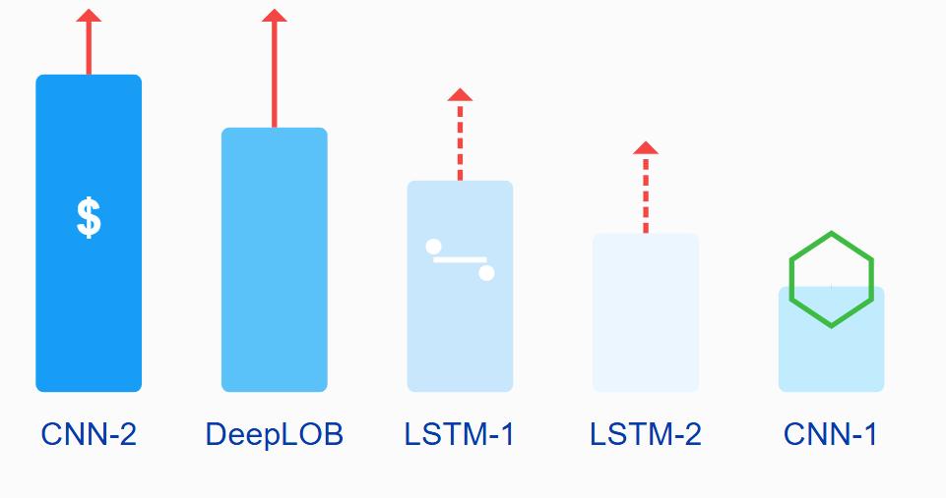
Key Observation and Takeaways
Observations
CNN-2 outperforms more complex DeepLOB in profits with better attack resilience
Sometimes the perturbations may act as a form of beneficial regularization
LSTM-2 and CNN-1’s simpler architecture creates "incidental robustness"
Practical Implications & Recommendations
Trade-off exists: highest-performing models (CNN-2, DeepLOB) are most vulnerable to attacks.
Balanced metrics matter: LSTM-1's consistent profitability under attacks offer safer deployment.
Attack type sensitivity: PGD generated worse profitable trading signals in CNN-2 and DeepLOB and FGSM did the same for LSTM
Notes:
Regulizer: Prevent models from learning noise or memorizing training data

Slide 42
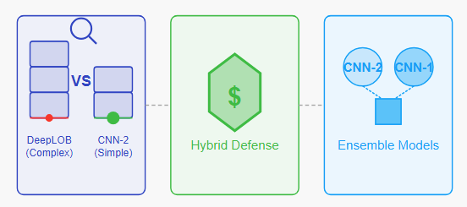
Future Research Direction
Investigate why simpler architectures (CNN-2) outperform more complex ones (DeepLOB with LSTM layer) in both profitability and attack resilience
Develop defense strategies combining adversarial training with model-specific optimizations to preserve profitability while enhancing security
Explore the effectiveness of ensemble approaches combining high-performing models (CNN-2) with highly stable ones (CNN-1) to balance profit and robustness

Slide 43
Reference
[1] Z. Zhang, S. Zohren and S. Roberts, "DeepLOB: Deep Convolutional Neural Networks for Limit Order Books," in IEEE Transactions on Signal Processing, vol. 67, no. 11, pp. 3001-3012, 1 June1, 2019, doi: 10.1109/TSP.2019.2907260.
[2] A. Tsantekidis, N. Passalis, A. Tefas, J. Kanniainen, M. Gabbouj and A. Iosifidis, "Forecasting Stock Prices from the Limit Order Book Using Convolutional Neural Networks," 2017 IEEE 19th Conference on Business Informatics (CBI), Thessaloniki, Greece, 2017, pp. 7-12, doi: 10.1109/CBI.2017.23.
[3] Paul Bilokon & Yitao Qiu, 2023. "Transformers versus LSTMs for electronic trading," Papers 2309.11400, arXiv.org.
[4] Lv, X., Zhang, L. (2021). Feature Fusion Learning Based on LSTM and CNN Networks for Trend Analysis of Limit Order Books. In: Mantoro, T., Lee, M., Ayu, M.A., Wong, K.W., Hidayanto, A.N. (eds) Neural Information Processing. ICONIP 2021. Lecture Notes in Computer Science(), vol 13111. Springer, Cham. https://doi.org/10.1007/978-3-030-92273-3_11[5] Gautam Raj Mode, Khaza Anuarul Hoque, Adversarial Examples in Deep Learning for Multivariate Time Series Regression, Accepted for publication in the 49th Annual IEEE Applied Imagery Pattern Recognition (AIPR) Workshop 2020
[5] F. Karim, S. Majumdar and H. Darabi, "Adversarial Attacks on Time Series," in IEEE Transactions on Pattern Analysis and Machine Intelligence, vol. 43, no. 10, pp. 3309-3320, 1 Oct. 2021, doi: 10.1109/TPAMI.2020.2986319.
[6] X. Yuan, P. He, Q. Zhu and X. Li, “Adversarial Examples: Attacks and Defenses for Deep Learning,” in IEEE Transactions on Neural Networks and Learning Systems, vol. 30, no. 9, pp. 2805-2824, Sept. 2019, doi: 10.1109/TNNLS.2018.2886017.
[7] A Review of Adversarial Attack and Defense for Classification Methods Yao Li, Minhao Cheng, Cho-Jui Hsieh, Thomas C. M. Lee August 18, 2021; revised: November 5, 2021
[8] Ding, D., Zhang, M., Feng, F., Huang, Y., Jiang, E., & Yang, M. (2023). Black-Box Adversarial Attack on Time Series Classification. Proceedings of the AAAI Conference on Artificial Intelligence, 37(6), 7358-7368. https://doi.org/10.1609/aaai.v37i6.25896
[9] A. Ntakaris, M. Magris, J. Kanniainen, M. Gabbouj, and A. Iosifidis, “Benchmark dataset for mid-price prediction of limit order book data with machine learning methods,” J. Forecasting, vol. 37, no. 8, 852–866, 2018.

Slide 44
Question(s)

Slide 45
Thank you everyone

Slide 46
Why did you use this dataset?
Citation Impact:
The original paper introducing the dataset has been cited over 200 times in academic literature, demonstrating its widespread adoption in the research community
Algorithmic Diversity:
It has been used to benchmark numerous machine learning approaches including CNNs, LSTMs, transformers, and reinforcement learning models for price movement prediction and order book modelling
Structured nature and clear documentation:
The dataset's structured nature and clear documentation have made it particularly valuable for reproducible research in financial machine learning, which is why it continues to be referenced in current academic publications despite being released in 2010

Slide 47
Advantages of the trading strategy used
Probability-Based Execution: Uses confidence thresholds (0.85-0.99) to filter for high-conviction trades
Directional Flexibility: Implements both long and short positions based on predicted price movements
Performance Optimization: Allows tuning of probability thresholds to balance trade frequency and accuracy
Risk Management: Allocates fixed budget per trade (e.g., $100) to control position sizing
Short-Term Focus: Uses a defined prediction horizon (k=4) ideal for high-frequency trading
Directional Simplicity: Reduces complexity by classifying movements into three states (up/stable/down)
Metric-Driven: Provides comprehensive performance metrics including win rate and profit per trade

Slide 48
FI-2010 Z-Score Normalisation
Z-Score Normalization: EXCELLENT for preserving relative importance of price jumps in LOB data
Min-Max Normalization: Scales features to [0,1] range - Beneficial when bounded outputs are required
Decimal Scaling: Divides by powers of 10 - Simple but less effective for handling LOB volume variations
Robust Scaling: Uses median and IQR - Well-suited for highly skewed LOB distributions
Log Transformation: Ideal for volume imbalance features with large ranges
Quantile Normalization: Maps values to target distribution - Useful but sacrifices magnitude information
Relative Normalization: Effective for analyzing price movements and trends
Z-Score normalization is optimal for LOB data as it preserves the statistical significance of order flow patterns while effectively standardizing across different price scales

